Slide 1

Data Mining: Final Project Presentation
RATING THE STARS
A Deep Dive into Google Play Store Apps
Team 7:
Shreya Sahay
Guruksha Gurnani
Gourab Mukherjee
Sajan Kumar Kar
12th December, 2023

Slide 2

OBJECTIVES
To analyze the trends surrounding the Google App market over the last decade.
To design a predictive model based on the app features to predict its rating.
To provide an insight into what truly makes an app stand out and become a favorite of the audience.

Slide 3
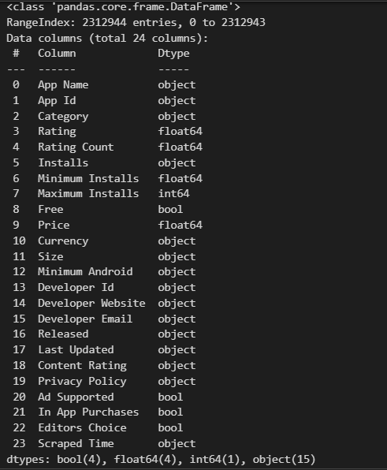
ABOUT THE DATASET
2.3M
24
Records
Columns
Our original dataset has records of 2,312,944 Google Play Store applications.
There are a total of 24 columns giving information about each app

Slide 4

DATA CLEANING
ADDRESSED MISSING AND DUPLICATE VALUES
1
DROPPED COLUMNS IRRELEVANT TO THE ANALYSIS
2
TRANSFORMATION OF DATA FORMATS
3
ENCODED CATEGORICAL VARIABLES
4
PERFORMED FEATURE ENGINEERING ON CERTAIN VARIABLES
5

Slide 5
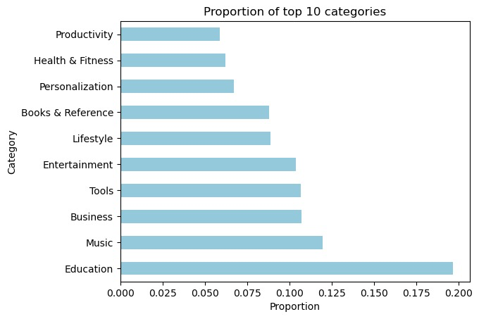
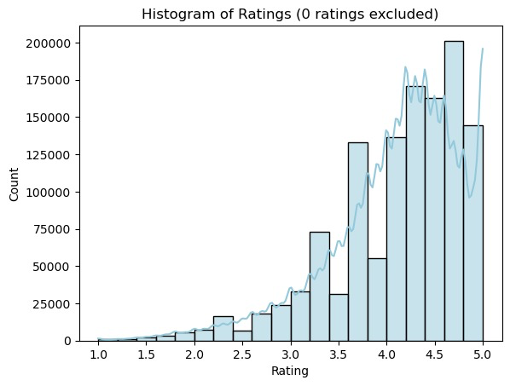
VISUALISATION OF INSIGHTS
Category and Rating Trends
The Education category takes up about 20% of all the apps
Most apps average a rating that is approximately between 3.5-5

Slide 6
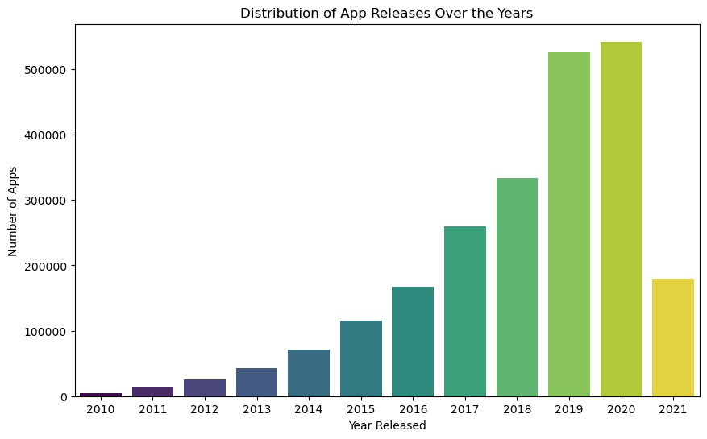
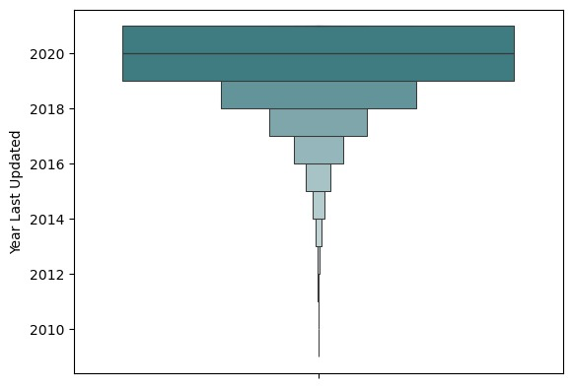
VISUALISATION OF INSIGHTS
App Release and Update
App Releases peaked in 2020, but suffered a major drop in 2021
Except for a few apps, most apps have been recently updated

Slide 7
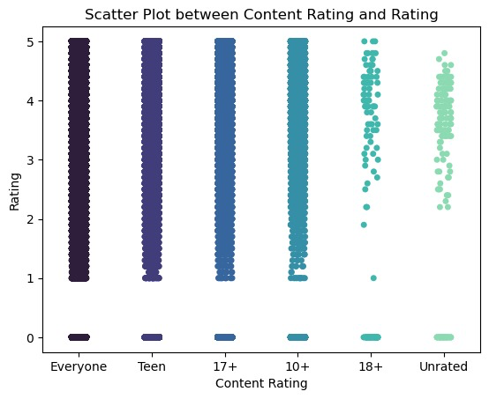
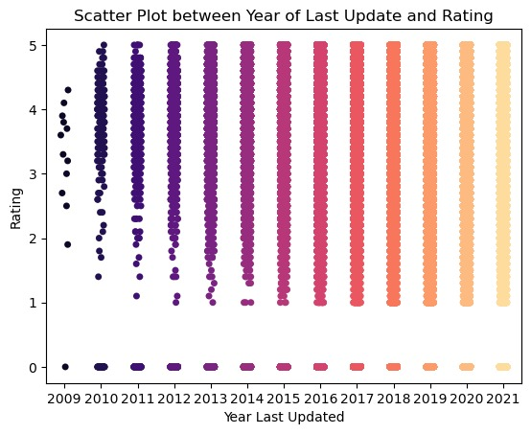
VISUALISATION OF INSIGHTS
Content Rating and Ratings based on last update
Apps that haven’t been updated for long have suffered less number of ratings
Apps with ‘Everyone’ Rating are the highest in number and also have the most number of ratings

Slide 8
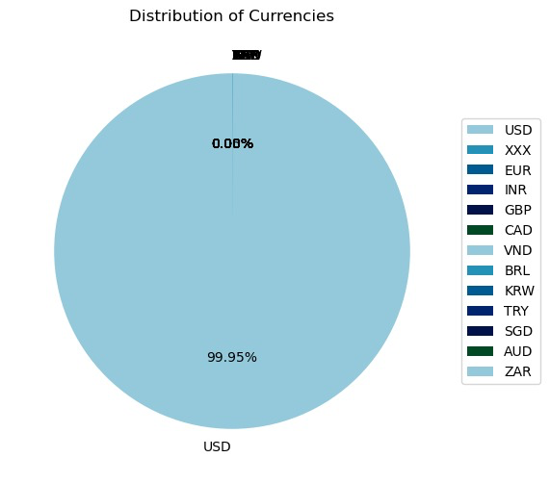
VISUALISATION OF INSIGHTS
Currency trends
The majority of apps are available in US dollars
The presence (albeit low) of 'XXX' indicates some instances where the currency information is unspecified or missing.

Slide 9
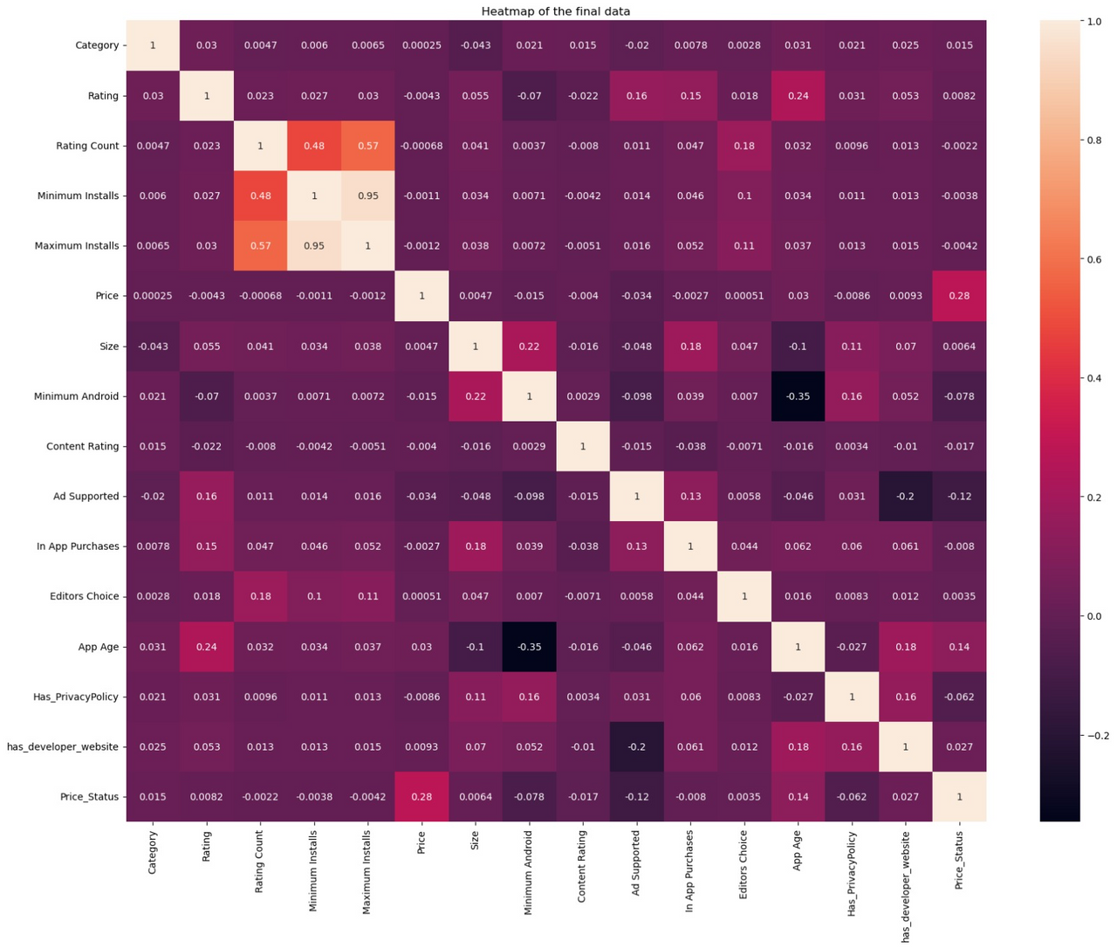
CORRELATION HEATMAP
Positive correlation: Min Installs-Rating Count
Negative Correlation: Min Andriod-App Age

Slide 10
SMART QUESTIONS BASED ANALYSIS
Is there a correlation between the "Minimum Android" version and the "Rating" of the apps?

Slide 11
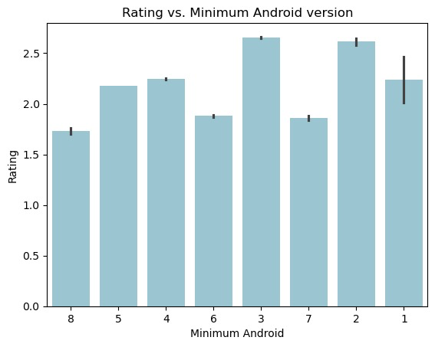
MINIMUM ANDROID VS APP RATING
Statistical Test: One-Way ANOVA
f-stat: 1833.0288
p-value: 0.00
We get a p-value of 0.00, which is less than alpha (0.05), so we reject the null hypothesis (H0). Hence, at least one pair of versions has a significantly different mean rating.

Slide 12
SMART QUESTIONS BASED ANALYSIS
2. Does having a website impact its rating?

Slide 13
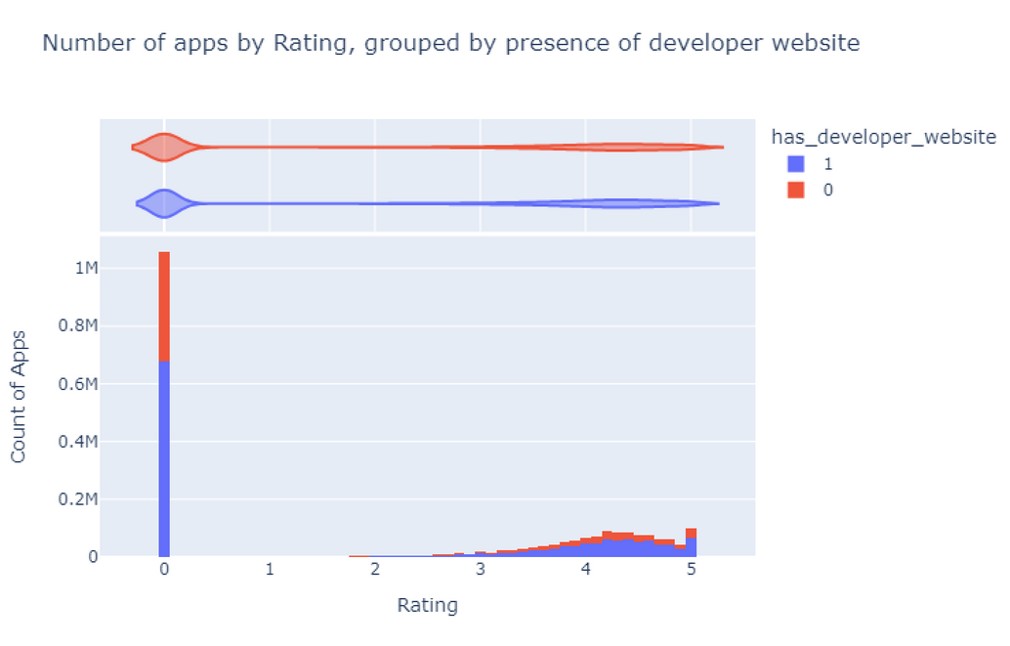
DEVELOPER WEBSITE VS APP RATING
Statistical Test: t-test
T-test Result (statistic=-80.475,
pvalue=0.0, df=225.0)
We obtain an extremely small p-value, which indicates that we can reject our null hypothesis and accept the alternate hypothesis.
Therefore, having a developer website does impact an app's rating.

Slide 14
SMART QUESTIONS BASED ANALYSIS
3. Do price and category significantly impact the popularity of an app in terms of installs?

Slide 15
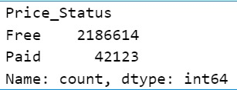
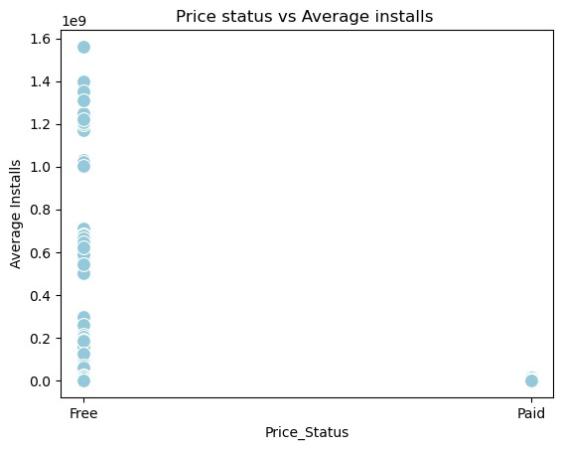
PRICE OF APP VS INSTALLS
Statistical Test: t-test
T-testResult (statistic=6.087, pvalue=1.150, df=2228735.0)
We get an extremely small p-value, so we reject the null hypothesis and conclude that there's a significant difference between mean installs for price status.

Slide 16
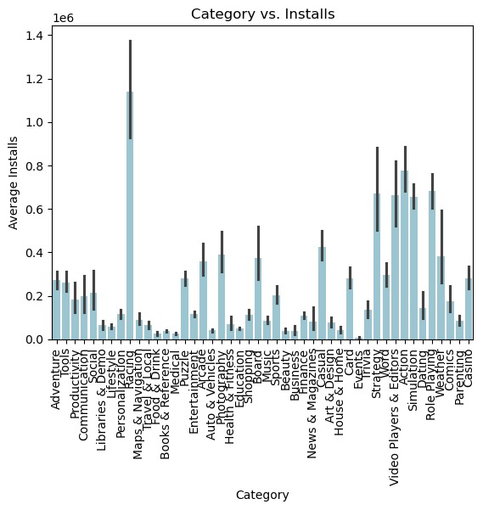
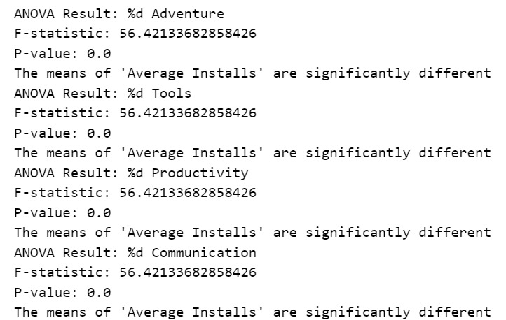
CATEGORY VS INSTALLS
Statistical Test: ANOVA

Slide 17
SMART QUESTIONS BASED ANALYSIS
4. Do price and category significantly impact the popularity of an app in terms of installs?

Slide 18
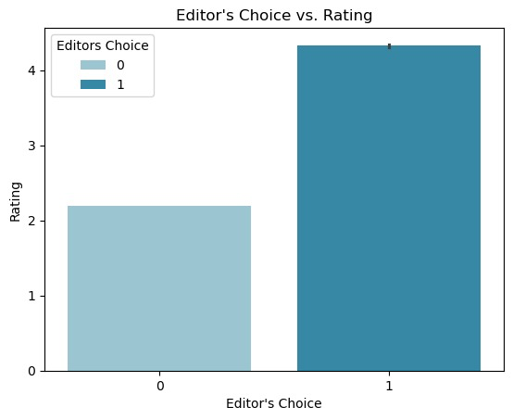
RATING VS EDITOR’S CHOICE
Statistical Test: t-test
T-test Result (statistic=-164.071, pvalue=0.0, df=222.0)
Also a smaller p-value, so we reject the null hypothesis and conclude that there is a significant difference in the mean rating for editor's choice.

Slide 19
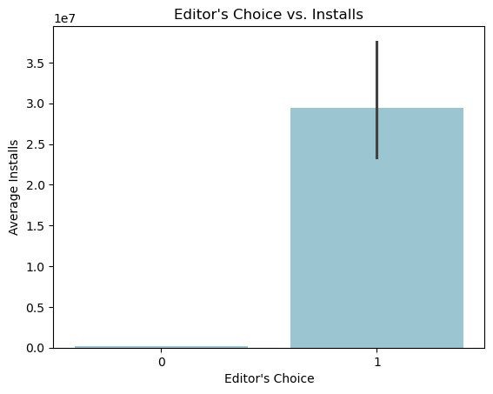
EDITOR’S CHOICE VS INSTALLS
Statistical Test: t-test
T-test Result(statistic=-164.071,
pvalue=0.0, df=222.0)
Also a smaller p-value, so we reject the null hypothesis and conclude that there is a significant difference in the mean installs for editor's choice.

Slide 20
SMART QUESTIONS BASED ANALYSIS
5. Does app size affect the number of installs?

Slide 21
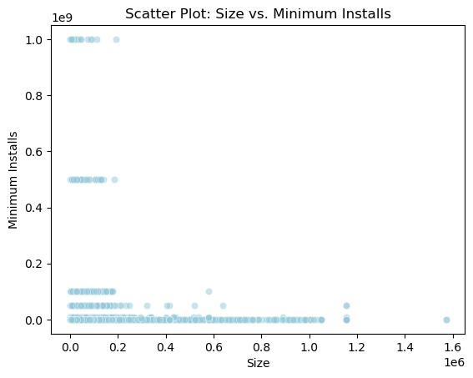
APP SIZE VS INSTALLS
Statistical Test: OLS Regression Results
Despite statistically significant relationships between 'Size' and 'Minimum Installs'/'Maximum Installs', the models exhibit limited practical significance due to:
low R-squared values
potential violations of model assumptions
high AIC/BIC values suggesting complexity, and
indications of multicollinearity issues, emphasizing the need for refinement

Slide 22
MODEL BUILDING AND ANALYSIS

Slide 23
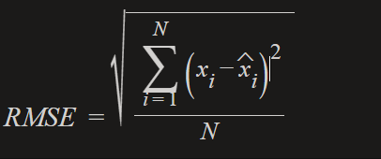
EVALUATION METRIC
The metric used is RMSE- Root Mean Squared Error
It is the square root of MSE
RMSE - Root Mean Squared Error
i = variable i
N = Number of non-missing data points
x_i = Actual observation
xiˆ = Predicted observation

Slide 24
LINEAR & SGD REGRESSION
LR Train RMSE:
3.96
LR Test RMSE:
3.98
SGD Train RMSE:
5.57 e+45
SGD Test RMSE:
5.26 e+45
Our linear regression model has been evaluated using the RMSE method.
We get a ~ 3.96 RMSE value in the train set and just a bit more, 3.98, on the test set, indicating that our model isn't overfitting.
We get a worse RMSE than the Linear model, it has now increased way beyond a bad error.

Slide 25
LGBM & DECISION TREE MODEL
LGBM Train RMSE:
0.1934
LGBM Test RMSE:
0.1936
DT Train RMSE:
0.2069
DT Test RMSE:
0.2071
Amazing result of an RMSE of 0.19. Best till now.
Decision Tree also returns good results, with an RMSE of 0.2. But the LGBM is still the better one.

Slide 26
HYPERPARAMETER TUNING
Methodology:
Bayesian Search (on LGBM)
The best set of hyperparameters are:
Learning rate: 0.1
max_depth: 16
n_estimators: 153
num_leaves: 31
reg_alpha: 0.063836718
Train RMSE:
0.1919
Test RMSE:
0.1924
Not much of an improvement over original LGBM but error improved by 0.0015.

Slide 27
CONCLUSION
Bring your app idea to us, and we can tell you how high its rating would be!

Slide 28
THANK YOU

